Slide 1

LightPriceBot
A Telegram bot to consult light prices throughout the day.
Gonzalo León Aragón & Jorge Bolinches Segovia

Slide 2
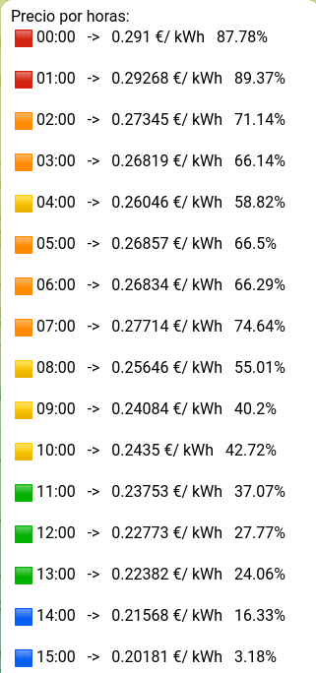
How it works 1
The bot is capable of the following:
Showing all prices for every hour of the day. Including percentages (0% = cheapest, 100% = priciest).
Showing a price for a specific hour or current hour.
Subscription to a certain percentage threshold. The bot will notify when the price goes up or below the specified value.
Remove subscriptions. Will delete any subscription.

Slide 3
How it works 2
There are 4 subprocesses:
Bot handler -> Receives Telegram messages and handles every command.
GetHours -> Asks the API once in a day and stores the data.
Scheduler -> Runs each hour and asks Subs to check for alerts. Also tells GetHours to recover data at 00:00
Subs -> Maintains a collection of chats that solicited alerts, when the alert is needed it sends it.

Slide 4
Decisions Taken 1
API usage.
Data about prices by hours is recovered from “https://gonzalo-leon.site:3000/horas”.
The original source is Red Eléctrica Española, but format of data is obfuscated and not very useful.
Instead we use an API created by Gonzalo for his TFG.
Storage of data -> Process that only asks the API once in a day. If a process needs this data they can ask for it.

Slide 5
Decisions Taken 2
How to manage alerts.
2 options:
User subscribes to alert -> New process that each hour calls the API to check if message needed.
User subscribes to alert -> Tell sub process to keep track of this user and each hour notifies all of the users.
Selected the second, it is more bulky but puts less strain in the API.

Slide 6
Decisions Taken 3
Use of GenServer
At first we used simple system of Spawn, Send and Receive. That made supervision harder.
We kept Scheduler process with spawn since it doesn't receive messages and its state is negligible.

Slide 7
Difficulties
We had to make a lot of changes when passing from normal processes to GenServer.
The TFG delivery was at the same time we were developing the Bot.
Hard time coordinating ourselves.

Slide 8
Frameworks and Libraries
We used ExGram and Tesla as Libraries.
The experience was fluid and easy.
Some of the methods ExGram uses are not so well documented, although it wasn’t hard to understand.
Tesla was really easy to use. To parse JSON we used the middleware from this library.

Slide 9
Conclusions
It was a really interesting project. The experience using a functional language was something new and refreshing.
Even with all the difficulties encountered, we are very satisfied with the result.
Learned a lot from APIs and frameworks, especially Telegram.

